Slide 1
Fuel Fabrication
NE 591

Slide 2
Last Time
Mining -> Processing -> Conversion -> Enrichment -> Powder -> Compaction/Sintering -> Rod/Assembly
U₃O₈ must be converted to UF₆ for enrichment, which is then converted to UO₂ powder for pellet manufacture
For different fuel types, enriched UF₆ follows a different path

Slide 3
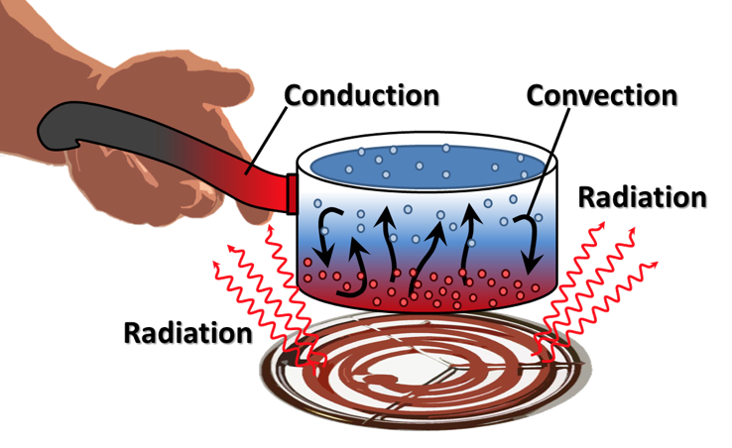
Last Time
General heat transport
Heat is produced in the fuel, transports through the cladding and gap, and into the coolant
The geometry of our problem
The initial condition of T
The boundary conditions of T
Is each parameter is a function of T
Thermal conductivity, heat capacity
Function of space/time?
Heat generation, dependent upon flux

Slide 4
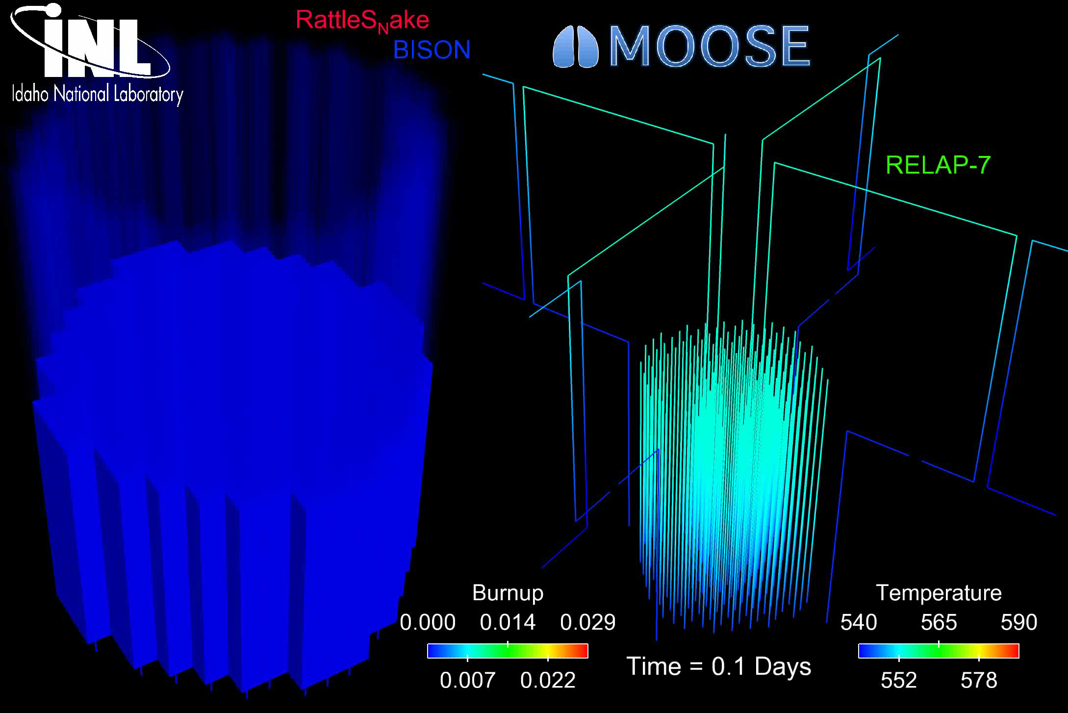
The most accurate solution is numerical, in 3D, requires modeling the entire core, and is multi-physics
Solution is 3D and changes in time
All the properties are functions of temperature
The boundary conditions comes from information about the coolant flow
The heat generation rate comes from information about the neutronics in the reactor
No analytical solution is possible

Slide 5
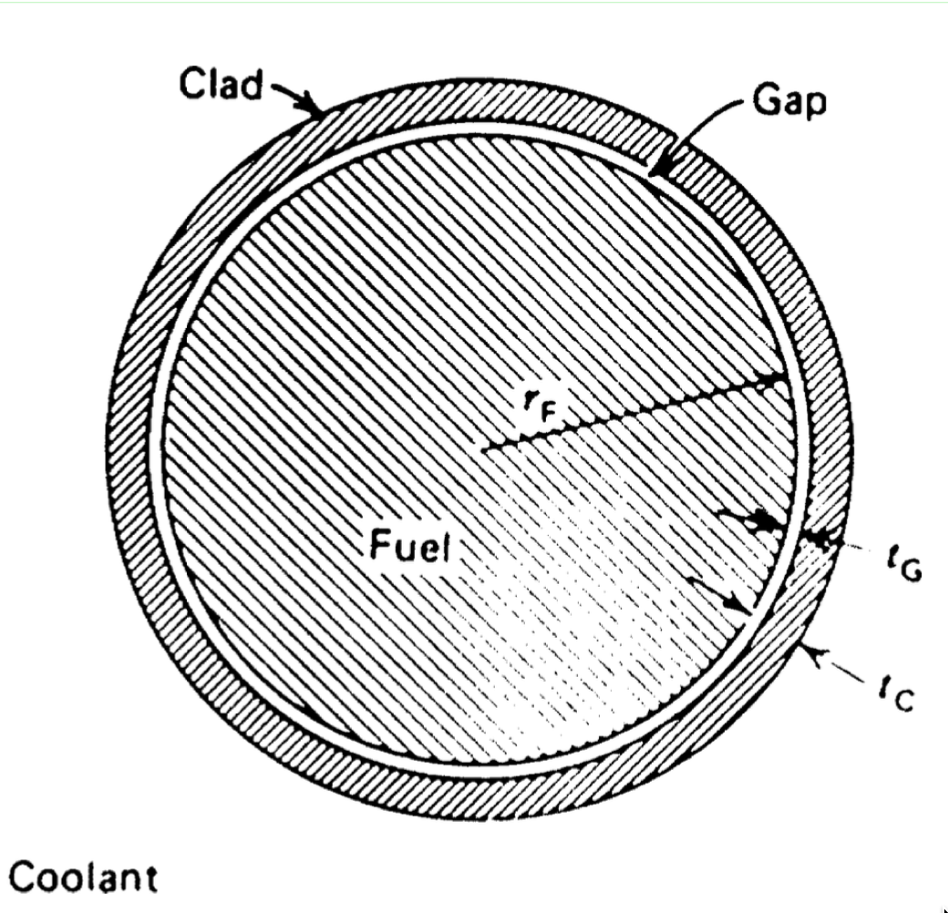
In order to solve, make assumptions!
#1: steady state ->
#2: axisymmetric ->
#3: constant in z
#4: constant thermal conductivity

